Slide 1
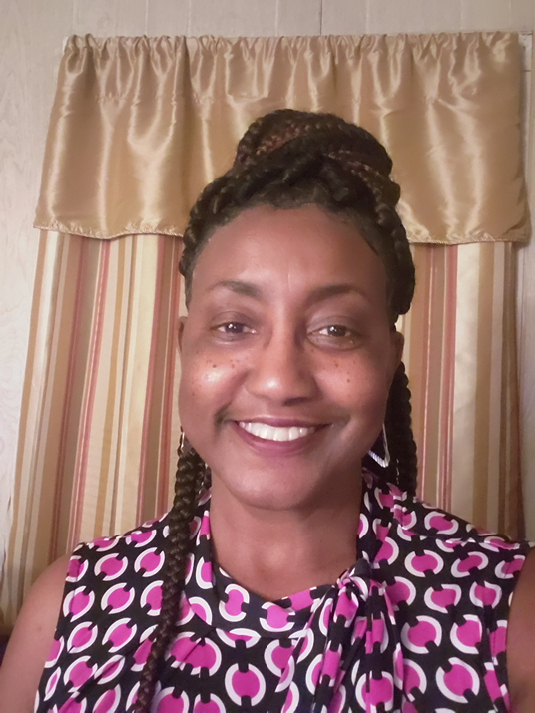
Ms. Harriett F. Godbee Special education teacher
I’ve worked in the Richmond County School System for 37 years.
For the past 25 years, I’ve worked as a Special Education Teacher in Richmond County Schools.
My passion is working with all children, but especially with Students with Disabilities.
I’m big on reading to students to get them thinking, making predictions, and responding to questions either by pointing to pictures, or verbally using their words.
I really enjoy doing arts and crafts with students by utilizing their large and small muscles.
I teach Language Skills, Cognitive Skills, Daily Living Skills, Motor Skills, and Social-Emotional Skills.
Class Dojo will be used as my mode of communication with parents.
I can be reached by email @ Godbeha@boe.Richmond.k12.ga.us or 706-737-7266

